Slide 1
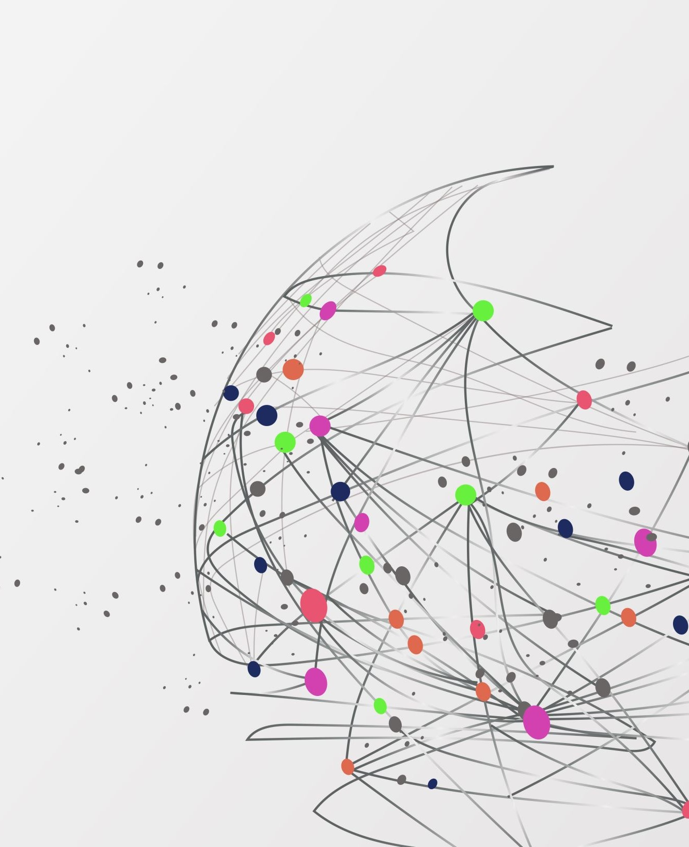
Ethics of Data Science and AI
Week 11 Thu: bias, privacy law, AI
Notes:
Week 11 Thursday, Ethical AI. This lecture covers essential outcomes 5.1 (laws and regulations) and 5.2 (unfair discrimination and social bias), and course learning objective 6 (weigh the ethical implications of AI). Structure follows the University of Michigan, Hagendorff (MIT AI Risk Repository) and University of Alberta guides on generative AI ethics: bias, privacy and data, harmful content, copyright and integrity, environment and labor, equity. Plan about 75 minutes: bias 25, laws 20, generative AI 20, discussion 10.

Slide 2
Ethics: telling right from wrong with data
Business
Who gets a loan, a job interview, a discount
Health
Who gets flagged for extra care
Transport
Routes, safety systems, self-driving
Civics
Policing, benefits, school admissions
Data decisions change real lives. Ethics asks: is this decision fair, lawful and honest?
Notes:
The state definition: ethics is the shared values that help people tell right from wrong. Data science now influences decisions in business, health, transportation and civics, so a person who uses data has to be able to tell an ethical decision from an unethical one. Ask: name one decision that was made about you by a computer this week (a recommendation, a loan check, a feed).

Slide 3
Where bias comes from
Source | What goes wrong | Example
Training data | Past unfairness is learned | Mostly male CEOs in the data: the model repeats it
Who is collected | Some groups are missing | A survey that only some people answer
Prompt wording | Assumptions steer the answer | Adding a demographic cue changes the output
Sycophancy | The tool agrees with you | A chatbot confirms your biased idea
A model is not neutral. It reflects the data it was given.
Notes:
Bias is a consistent unfairness in how data or a model treats groups. It enters at four points. Training data reflects the world that produced it, including its unfairness. Collection decides who is in the data at all, which links to sampling bias from Week 2: voluntary response and nonresponse leave groups out. Prompts and wording can carry assumptions: demographic cues can change a model's answer. Sycophancy means chatbots tend to agree with the user instead of challenging a biased idea. Sources: University of Alberta guide, University of Michigan article.

Slide 4
Example: what image generators show us
Who appears
Men about 3 times as often as women.
Which jobs
High-paying jobs: mostly lighter skin. Low-paying jobs: mostly darker skin.
"Politician", "lawyer", "judge", "CEO" produced almost entirely light-skinned men.
Bloomberg test of Stable Diffusion, 2023, reported by the University of Michigan.
Notes:
University of Michigan cites a 2023 Bloomberg test of the Stable Diffusion image generator. High-paying jobs were shown mostly with lighter-skinned people and low-paying jobs with darker-skinned people. Men appeared about three times as often as women. Women appeared mainly in lower-paying or traditional roles such as housekeeper. Prompts such as politician, lawyer, judge and CEO produced almost entirely light-skinned men. Point out: nobody programmed this rule. The model learned it from its training data. Activity: ask students what a fair result would be, and who decides.

Slide 5
Bias and fairness are not the same word
Bias
An unfair tilt in the data, the model, or the result.
Fairness
The goal we check against. Say which meaning you use.
Check | Question
Presence | Is every group in the data?
Errors | Does the model make the same mistakes for every group?
Notes:
Bias is the unfair tilt we find in data, a model or an outcome. Fairness is the goal we are checking against. There is no single definition of fair, which is why we always say which one we use. Three simple checks students can do: does each group appear in the data in a reasonable share, does the model make the same kinds of mistakes for each group, and do similar people get similar results. Say that when two fairness goals conflict, people have to decide and explain the choice. That is an ethical decision, not a math one.

Slide 6
Bias in lending, medicine and policing
Field | What happened | Lesson
Lending, insurance | Models learn from past approvals | Past unfairness gets copied
Medicine | A hospital algorithm used past spending as a stand-in for need (2019 study) | The wrong target column hides bias
Policing | COMPAS risk score: more false "high risk" labels for Black defendants (ProPublica, 2016) | Error rates differ by group
Hiring | An experimental recruiting tool downgraded resumes mentioning women (Reuters, 2018) | Learning from history repeats history
Notes:
Three well-documented cases, plus lending as the textbook risk. Lending and insurance: models trained on past decisions copy past discrimination; neighborhood or zip code can stand in for race. Medicine: Obermeyer and colleagues (Science, 2019) found a widely used US hospital algorithm used past health spending as a stand-in for health need, so it underestimated the needs of Black patients, who had spent less at the same level of illness. Policing: ProPublica (2016) found the COMPAS risk score wrongly labeled Black defendants as high risk more often than white defendants; the makers disputed the fairness definition, which shows fairness has more than one meaning. Hiring: Reuters (2018) reported Amazon dropped an experimental recruiting tool that learned to downgrade resumes mentioning women. Check these citations before using them in an assignment key.

Slide 7
Removing a column does not remove bias
1 Sensitive column: Gender, Race, Age
What to do
Keep the sensitive column to check results by group.
Ask of every feature: could this stand in for it?
2 Delete it from the model
3 Proxy column: zip code, name, school
4 Bias can still come back through the proxy
Notes:
Students might think: just delete the column Race or Gender and the model is fair. It is not. Other columns can act as a proxy: zip code, name, school, or purchase history can reveal the removed information. This connects directly to feature engineering from Weeks 5 and 6: when we choose, create or drop features, we are making a fairness decision. Remind them to keep the sensitive column out of the model but still use it to check results by group. Example from the game dataset: Platform and Age could stand in for income.

Slide 8
Spot the bias: three cases
Case | Where is the bias?
A loan model trained on past approvals uses zip code. | Unfair history in the data, plus a proxy column
An app rates its own fairness from voluntary reviews. | Voluntary response: only some people are in the data
A face tool tested mostly on one group fails on others. | A group is missing from the data
For each case, name where the bias entered and one fix.
Notes:
Practice. Let pairs discuss for two minutes, then ask for answers. 1: The training data (past approvals) is unfair, and the zip code is a proxy. 2: Only people who chose to respond are in the data: voluntary response. 3: The model works well for the group that dominates the data and poorly for the group that is missing. Ask for one fix each: remove the proxy and check results by group; collect from a random sample; add data for the missing group.

Slide 9
How to reduce bias
1 Look
Who is in the data? Who is missing?
2 Split
Compare results for each group
3 Document
Write down limits and choices
4 Review
A person checks decisions that matter
If it cannot be made fair, the ethical choice may be not to use it.
Notes:
Practical habits. They match the cleaning and EDA habits of the course: look at the data first. Check who is in the data and who is missing. Compare results by group, not only overall. Write down limits and assumptions in the report, as the assignment already asks. Keep a human in the loop for decisions that change someone's life. If the model is unfair and cannot be fixed, the ethical choice may be not to use it.

Slide 10
Personal data: what the law protects
Direct
Name, email, ID numbers.
Indirect
Location, device, face, voice, birth date plus zip code.
Sensitive
Health, money, children, biometrics.
Combining harmless columns can identify a person.
Notes:
Outcome 5.1 starts with what is protected. Personal data is information that identifies a person directly or can be combined to identify one. Direct: name, email, ID numbers. Indirect: location history, device ID, face, voice. Sensitive categories get extra protection: health, finances, children's data, biometrics. Our course datasets are synthetic or anonymous, and Player ID is a code, not a name. Discuss: a data set with only birth date, zip code and gender can often identify a person.

Slide 11
Laws that protect personal data
Law | Where | What it covers
GDPR | European Union | Data about people in the EU; consent, access, deletion; fines up to 4% of turnover
CCPA / CPRA | California | Right to know, delete, and opt out of sale
HIPAA | United States | Health information held by providers and insurers
FERPA | United States | Student education records
COPPA | United States | Data from children under 13
Ohio | Ohio | Breach notice; 2018 safe harbor; no full privacy law as of May 2026
Notes:
Outcome 5.1: identify relevant laws, rules and regulations. GDPR: the EU General Data Protection Regulation, in force since 2018. It applies to data about people in the EU even if the company is elsewhere; fines can reach 4 percent of worldwide yearly turnover or 20 million euros, whichever is higher. CCPA: California Consumer Privacy Act, with later amendments (CPRA), gives California residents rights to know, delete and opt out of the sale of their data. HIPAA: US federal law for health information held by healthcare providers, insurers and their partners. FERPA: US federal law protecting student education records, which applies to them as students. COPPA: US federal rule on collecting data from children under 13. Ohio: as of May 2026 Ohio had not enacted a comprehensive consumer privacy law; bills had been introduced but not passed. Ohio does have a data breach notification law and the Ohio Data Protection Act of 2018, which gives businesses with a recognized cybersecurity program a legal defense after a breach. Tell students laws change; the habit is to check the current rule for the place the data comes from.

Slide 12
Four ideas that privacy laws share
Consent
Say what you collect and why
Minimum
Collect only what you need
Rights
See, correct, delete my data
Security
Protect it. Tell people if it leaks
If a column is not needed, drop it. It also lowers the privacy risk.
Notes:
Rather than memorize every law, students learn the shared ideas. Consent and notice: tell people what you collect and why. Data minimization and purpose: collect only what you need and use it for the stated purpose. Rights: people can see, correct and delete their data. Security and breach notice: protect the data, and tell people if it leaks. These are also good data-science habits. Connect to Week 3: if a column is not needed, drop it; that also reduces privacy risk.

Slide 13
Generative AI and your data
Risk | What to do
Prompts may be stored or used for training | Read the privacy policy and account settings
48% of employees surveyed entered non-public company data (Cisco, 2024) | Never paste personal or confidential data
Vendors are vague about training data | Research the tool and company first
Assume the provider can see what you type.
Notes:
From University of Michigan and University of Alberta. Training data collection raises privacy questions. What you type into a tool may be stored and used to train it, and the opt-out is often buried in long terms of service. Cisco's 2024 Data Privacy Benchmark Study, cited by Michigan, found many organizations limit or ban generative AI over privacy and security concerns, and that 48 percent of surveyed employees admitted entering non-public company information. Vendors are often vague about their training data. Rule for the class: never paste personal, confidential or someone else's private data into a public tool. Assume the provider may see it.

Slide 14
Wrong answers and fake media
Hallucination
Confident, fluent, and wrong. Sources can be invented or misdescribed.
Verify every claim.
Deepfakes
Fake media of a real person, made without consent. Used to harass and mislead.
Disclose AI use.
Check a claim against a real source before you share it.
Notes:
Hallucination: models produce fluent, confident, false content, including invented sources, even when connected to search. Citations may not match what the source says. Verify any specific claim before using it. Harmful content: synthetic media is made with a person's permission, deepfakes impersonate someone without consent and are used to harass and spread hate. Creating them is now cheap. Disclosure rules for synthetic media are being proposed. Habit: say when AI helped, and check claims against a real source. Hagendorff's review lists hallucinations and harmful content among the most discussed issues.

Slide 15
Copyright and your own work
Issue | What to do
Who owns AI output? Unsettled | Do not assume it is free to publish
Uploading copyrighted material | Get permission first
Submitting AI work as yours | That is misconduct. Disclose what you used
Course rule | AI may help with code. The analysis must be yours
Notes:
Copyright questions are still open: when training on copyrighted works is allowed, when you may upload copyrighted content, who owns AI output, and who is responsible when output copies protected work. Michigan reports that about 70 percent of tools studied did not state license terms for their outputs. Academic integrity: submitting AI output as your own is misconduct; disclose which tools you used and how. The course policy in Assignment 1: you may use generative AI for code or navigating Orange, but the analysis must be your own and you may be asked to explain it.

Slide 16
Hidden costs: energy, labor and access
Issue | What the guides say
Environment | Large models use electricity and cooling water; the full impact is hard to measure
Human labor | Labeling and moderation work is often low-paid and outsourced; workers may see disturbing content
Equity and access | Less common languages are underrepresented; cost and internet access limit use
Benefit to weigh | Accessibility help: simpler text, alt text, step-by-step plans
Notes:
Three more issues from the guides. Environment: training and running large models uses electricity and cooling water; Michigan cites reports that training GPT-3 produced greenhouse gas comparable to a gasoline car driving a million miles, and that generating one image can use about as much energy as charging a phone. The full impact is hard to measure; present these as reported estimates. Human labor: Alberta notes data labeling and content moderation are often outsourced to workers in the Global South who may be paid little and see disturbing content. Equity and access: training data favors data-rich languages, and cost or internet access limits who can use the tools. Balance: the same tools help students with disabilities with plain-language text, alt text and step planning. Hagendorff's review notes the literature focuses disproportionately on risks, so weigh benefits too.

Slide 17
Researchers mapped 19 areas of concern
Area group | Includes
Fairness and safety | Fairness and bias, safety, alignment, evaluation and auditing
Content and trust | Harmful content, hallucinations, transparency, interaction risks
Data and law | Privacy, security, copyright, governance and regulation
Society | Labor and economy, education, art, writing and research, sustainability
378 issues, 19 areas (Hagendorff, 2024). We covered most of them today.
Notes:
Hagendorff (2024), listed on the MIT AI Risk Repository, reviewed the literature on the ethics of generative AI and built a taxonomy of 378 issues in 19 topic areas. Show that our lecture touches most of them. The review also notes that the literature focuses disproportionately on risks and that some risk scenarios lack substantiation, which is a useful reminder to ask for evidence. Students do not memorize the 19; they use the list to see how wide the field is.

Slide 18
Five questions before you use a tool
1 Is the benefit worth the energy it uses?
2 Does uploading this content raise copyright or privacy issues?
3 What data does the tool keep about me?
4 How will I check that the answer is true?
5 How will I check the output for bias?
Notes:
From the University of Alberta guide and Michigan practical tips. Make this the take-home checklist and tie it to the assignment: students write one sentence for any generative AI use. Also research the tool and company and read the terms.

Slide 19
Discussion: which law, which bias?
Case | Ask
A clinic uses an AI tool to flag patients for follow-up. | Which law? Whose data is missing?
A kids' game collects the birthdays of players aged 10. | Which law applies?
A US company trains a model on customers in Germany. | Which law applies?
Name the law, name the bias, name one fix.
Notes:
Closing activity, about ten minutes. 1: HIPAA applies to the clinic data; also bias if the training data is from one group. 2: COPPA, because the users are under 13. 3: GDPR applies because the people are in the EU, even though the company is in the US. Ask for the bias type too (training data, missing groups, proxies).

Slide 20
Sources for this lecture
Source | Used for
University of Michigan, Ethical Considerations of Using GenAI Tools (2025) | Bias, data, copyright, environment, equity, tips
Hagendorff (2024), Mapping the Ethics of Generative AI, MIT AI Risk Repository | 19 areas and 378 issues
University of Alberta Library, GenAI Ethics guide | Labor, accessibility, integrity, questions to ask
Privacy laws in Ohio overview (privacyon.com, May 2026) | Ohio privacy status
Notes:
Reading list for students. Fetched November 2026. Verify the Ohio privacy status near the lecture date.

